Slide 1
JAVA Lecture 20
Networking in JAVA

Slide 2
What is Networking in Java?
Networking allows two or more machines to communicate and exchange data.
Java Networking API is built on TCP/IP protocols.
Key components:
✅ IP Address
✅ Port Number
✅ Protocol (TCP/UDP)
✅ Socket (end-point for communication)

Slide 3
Key Classes in Java Networking (java.net)
Class | Purpose
InetAddress | Handles IP address operations
Socket | Represents a client-side TCP connection
ServerSocket | Listens for incoming connections
URL | Represents a web resource
URLConnection | Used to read/write from/to a URL
✅ All networking classes are part of the java.net package.

Slide 4
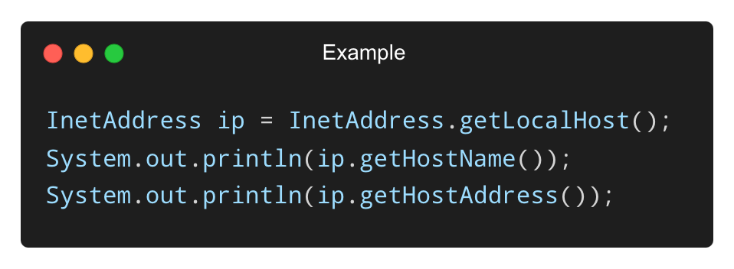
Understanding IP Addresses and Ports
IP Address: Unique identifier for a device on a network.
Example: 192.168.1.10
Port Number: Identifies a specific process/service.
Example: HTTP uses port 80, FTP uses 21
Java uses InetAddress to work with IPs:

Slide 5
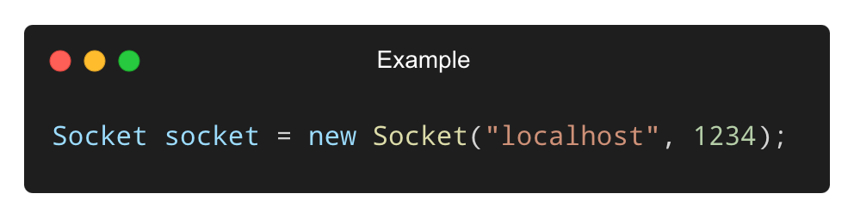
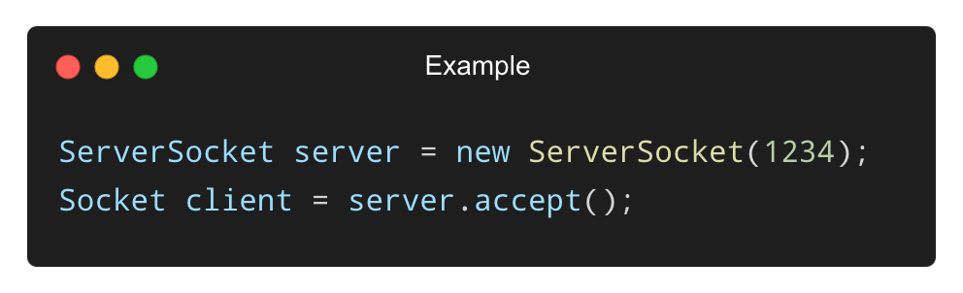
Socket Programming – The Basics
• Socket: End-point of a two-way communication link.
• Types:
✅ Client Socket (Socket) – initiates communication.
✅ Server Socket (ServerSocket) – listens for clients.
• Client Example:
• Server Example:

Slide 6
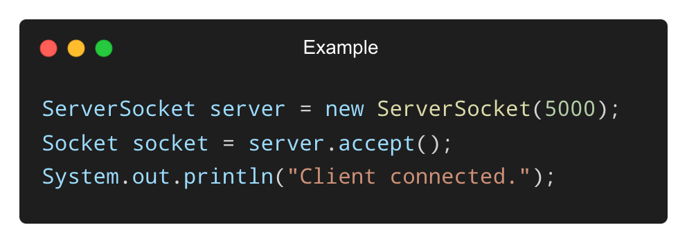
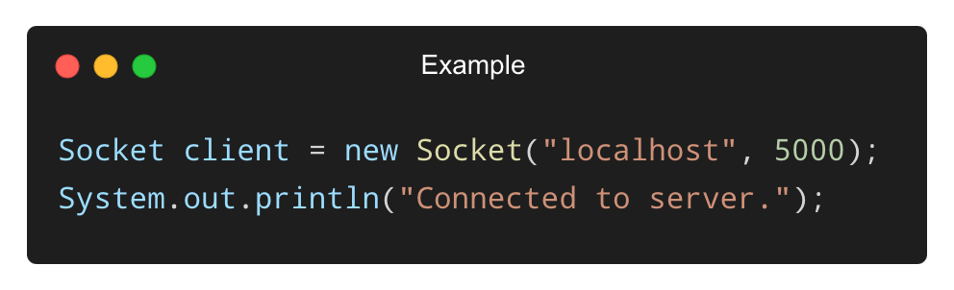
Simple Client-Server Communication Example
• Server Side:
• Client Side:

Slide 7
TCP vs. UDP in Java
Protocol | TCP | UDP
Connection | Connection-oriented | Connectionless
Reliability | High | Low
Speed | Slower | Faster
Classes | Socket, ServerSocket | DatagramSocket, DatagramPacket
✅ TCP is used for reliable communication (e.g., chat apps).
✅ UDP is used for fast, real-time apps (e.g., gaming).

Slide 8
What is InetAddress in Java?
• A class used to represent IP addresses.
• Can resolve hostnames to IP addresses and vice versa.
• Common methods:
✅ getLocalHost() – Gets local IP
✅ getByName("hostname") – Gets IP from name
✅ getHostName() – Gets host name
✅ getHostAddress() – Gets IP address

Slide 9
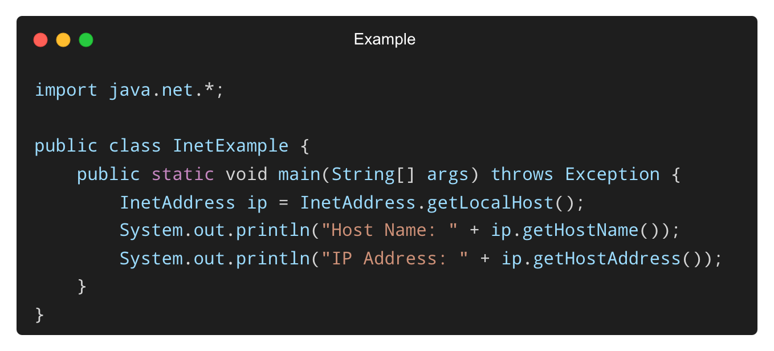
Example – Using InetAddress
✅ Helps in resolving and displaying IP-related information.

Slide 10
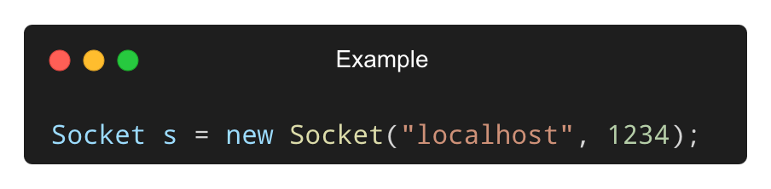
What is the Socket Class?
• Represents the client-side of a TCP connection.
• Enables sending and receiving data to/from a server.
• Constructor example:
Methods:
getInputStream() – to read data
getOutputStream() – to write data
close() – to close the connection

Slide 11
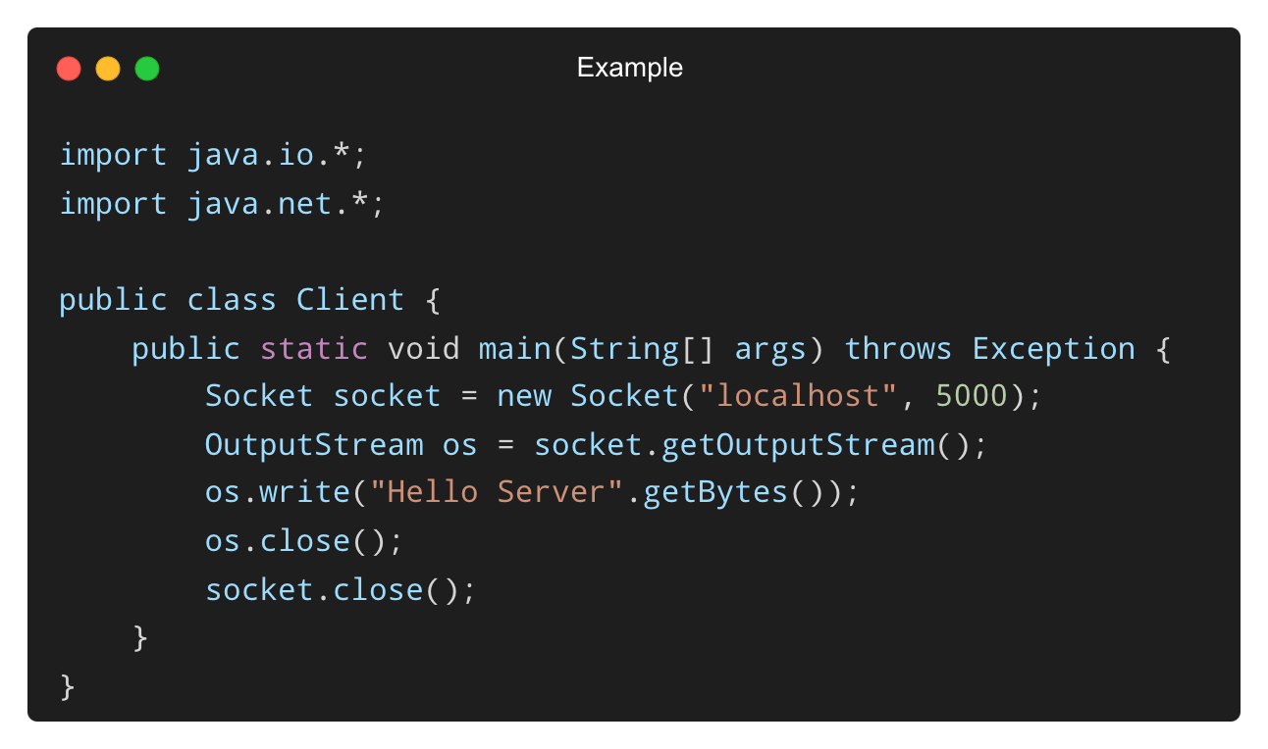
Example – Simple Client using Socket
✅ Connects to server on port 5000 and sends a message.

Slide 12
Understanding Socket Lifecycle
1️⃣ Create a Socket object with hostname and port
2️⃣ Send or receive data using streams
3️⃣ Close the socket to free the resources
✅ Follows the connect → communicate → disconnect pattern

Slide 13
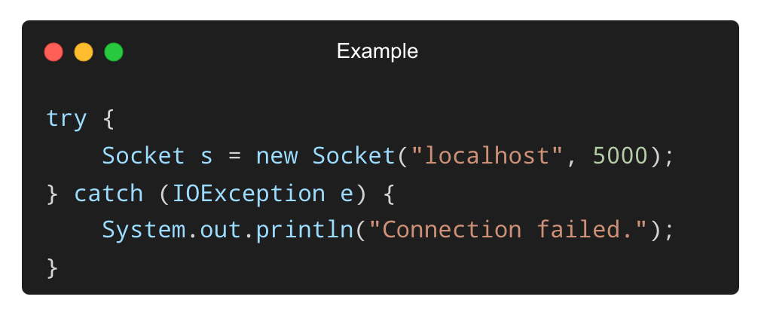
Handling Exceptions in Socket Programming
• Common exceptions:
❌ UnknownHostException – Host not found
❌ IOException – Error in I/O or stream handling
• Wrap socket code in try-catch blocks:

Slide 14
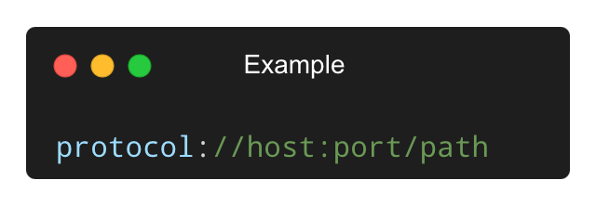
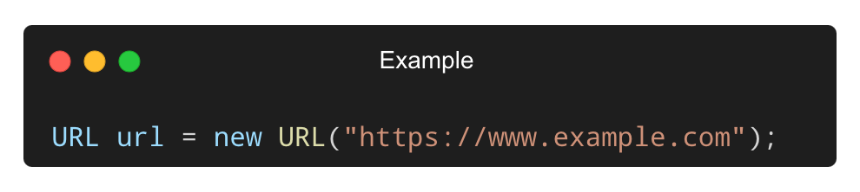
What is the URL Class?
URL stands for Uniform Resource Locator – it points to a resource on the web.
Used to connect to files, APIs, or websites.
Belongs to java.net package.
URL Format:
Constructor Example:

Slide 15
Common Methods of the URL Class
Method | Description
getProtocol() | Returns the protocol (e.g., http, https)
getHost() | Returns the hostname
getPort() | Returns the port number
getPath() | Returns the file/path part
openConnection() | Returns a URLConnection to the resource

Slide 16
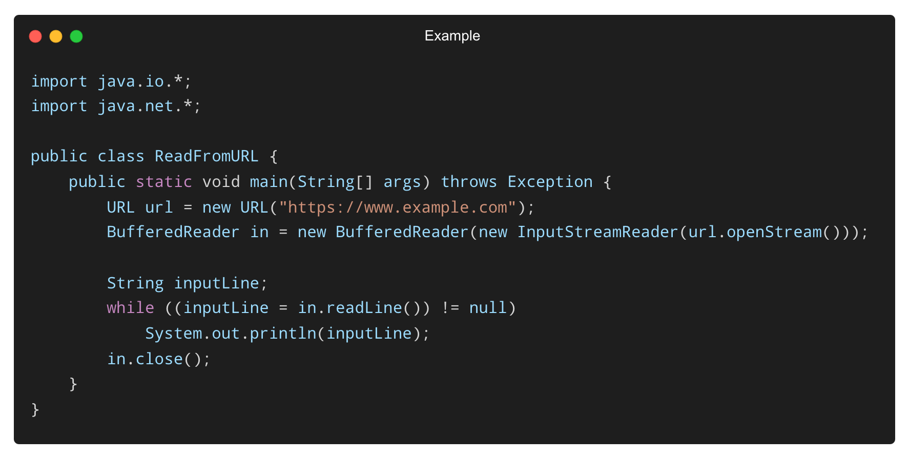
Reading Content from a URL
✅ Fetches and displays webpage content line by line.

Slide 17
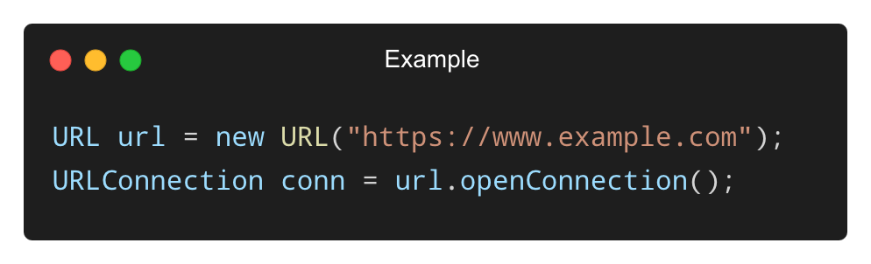
What is URLConnection?
A class that represents a communication link between the Java app and a URL.
Created by calling openConnection() on a URL object.
Example:
You can configure connection properties before opening it.

Slide 18
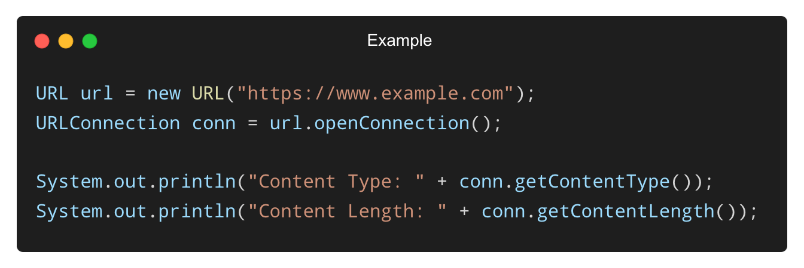
Reading Headers and Content Using URLConnection
✅ Useful for reading metadata like headers, content-type, etc.

Slide 19
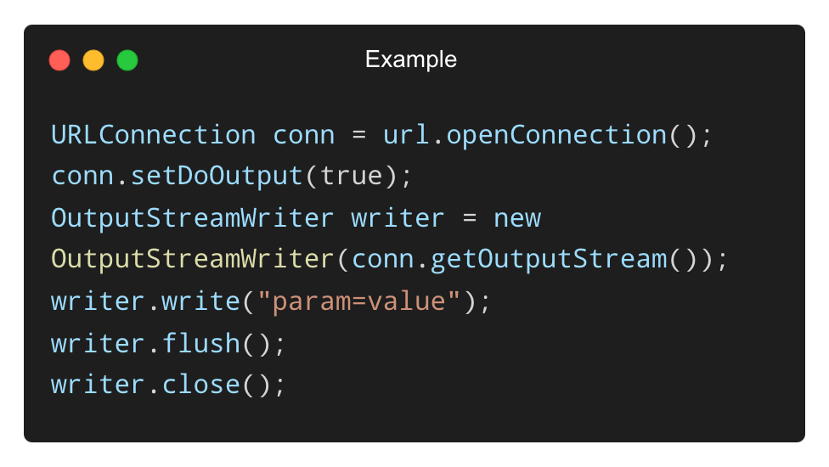
Writing Data with URLConnection (For POST requests)
• You can also send data to a server if needed:
✅ Used when sending form data or JSON to web servers.

Slide 20
THANK YOU

